Slide 1

THE PVPS ANNUAL SHORT STORY COMPETITION 2024!

Slide 2

The judges…
(Us)

Slide 3

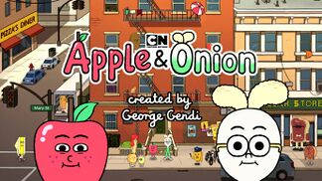
What’s a short story?
A short story is a brief tale that tells about something exciting or interesting. It’s like going on an adventure with your imagination.
It has a beginning, middle and end – just like your favourite movies or TV shows.

Slide 4
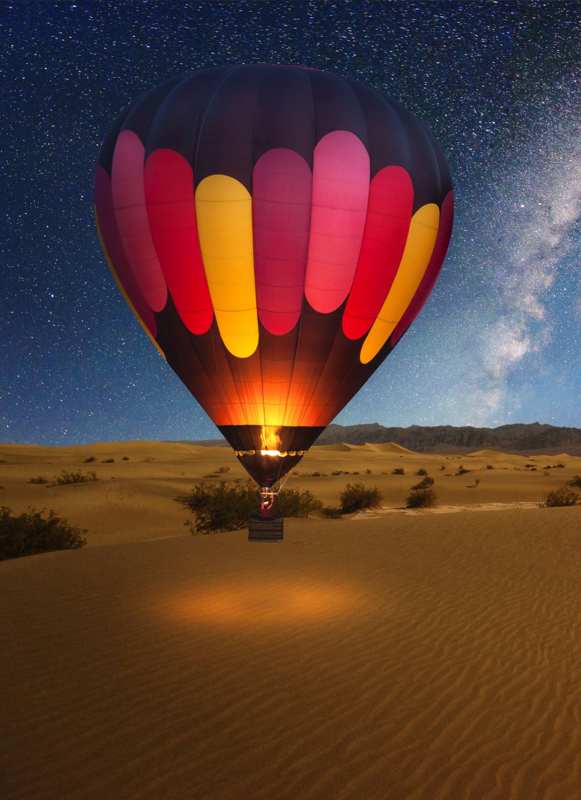
Getting started
Coming up with an idea you can get a whole story out of is often the hardest bit!
We all get ideas from different places.
You can draw inspiration from:
Observing the world around you.
Asking “What If” questions: What if one day the sun didn’t rise? What if one day all the cars on earth stopped working?
Your own life; your experiences, emotions and challenges.
Books you’ve read or fairytales and myths that you could retell in a modern way.
Your dreams.

Slide 5
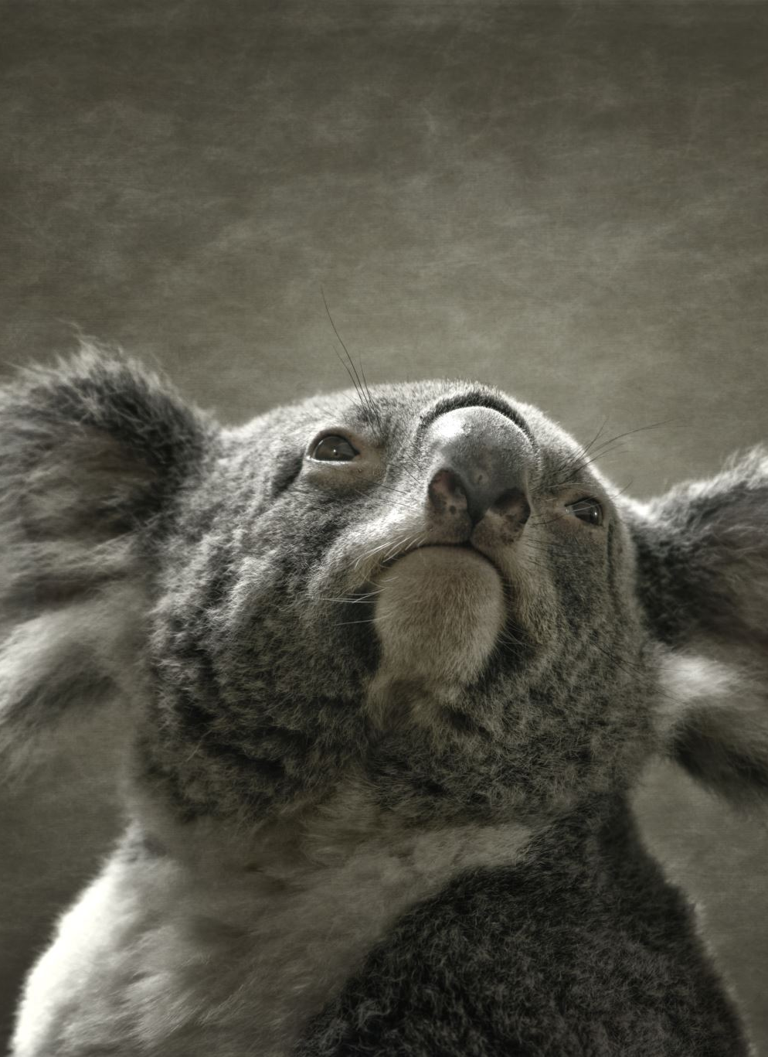
Your characters
Who will be in your story?
People, animals or magical creatures?
What’s important is that your characters are memorable.
How can you make them memorable?

Slide 6
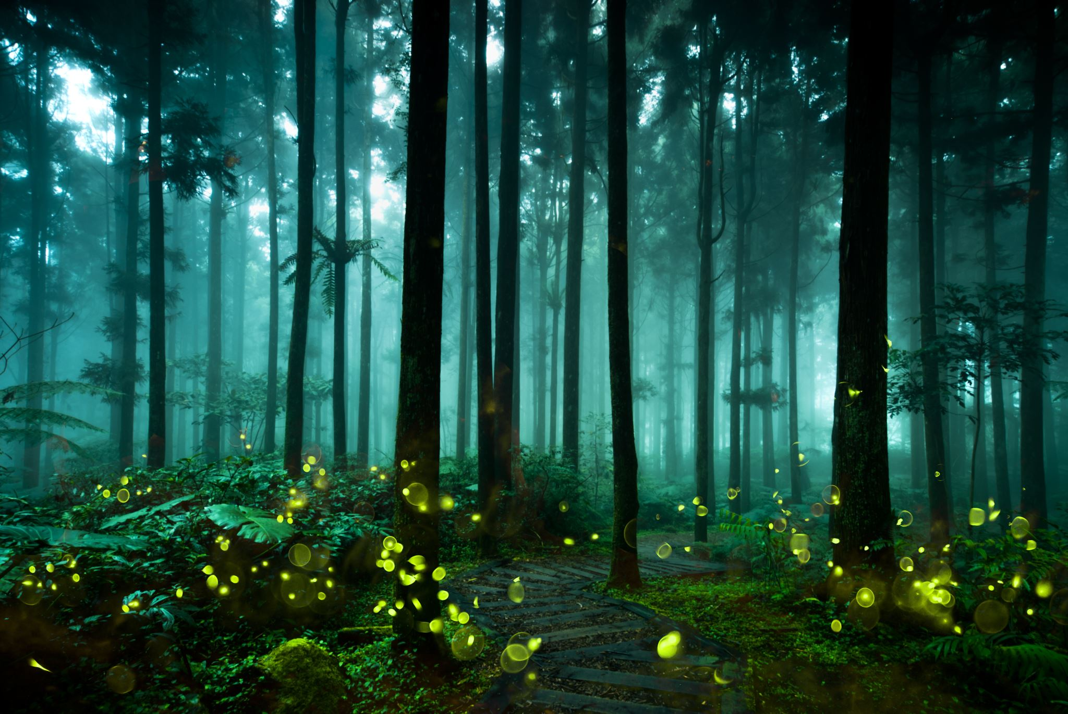
The setting
Where does your story happen? In a magical forest, a city or in outer space? Or maybe even in your house with the squeaky back door.
How can you make a reader see it how you do?
Make it come alive!

Slide 7
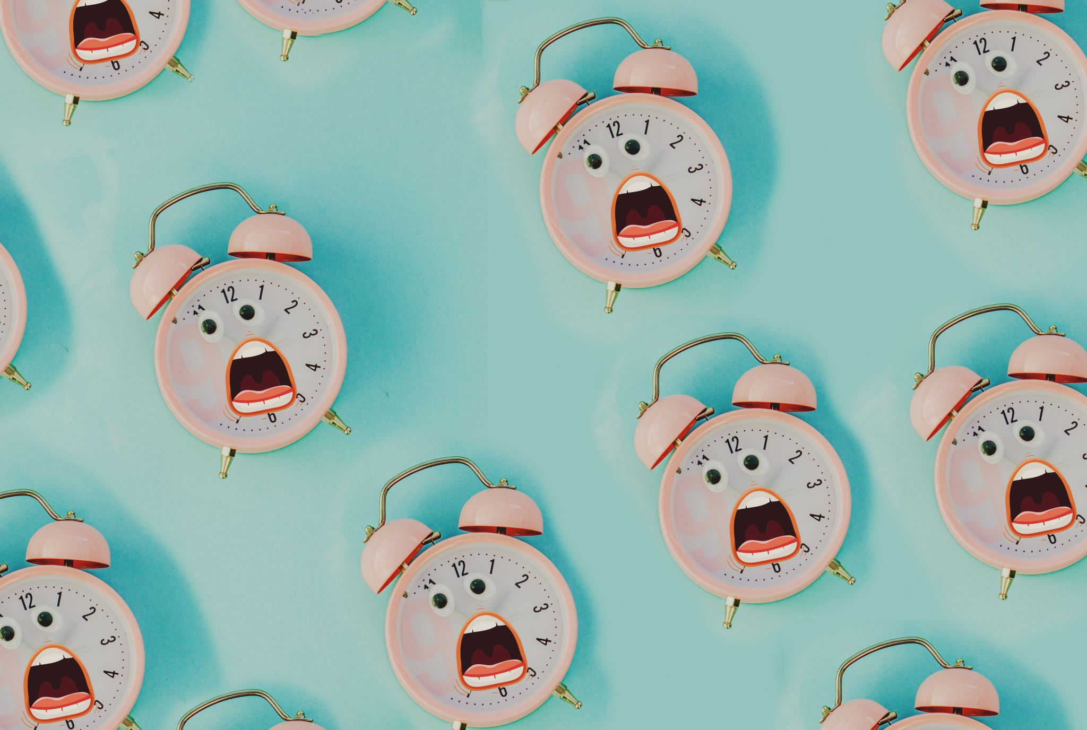
The beginning
Start with a bang! Grab your reader’s attention from the first line.
“As Gregor Samsa awoke one morning he found himself transformed in his bed into a gigantic insect.”
“It was a bright cold day in April and the clocks were striking 13.”
“A mouse took a stroll through a deep dark wood…”

Slide 8
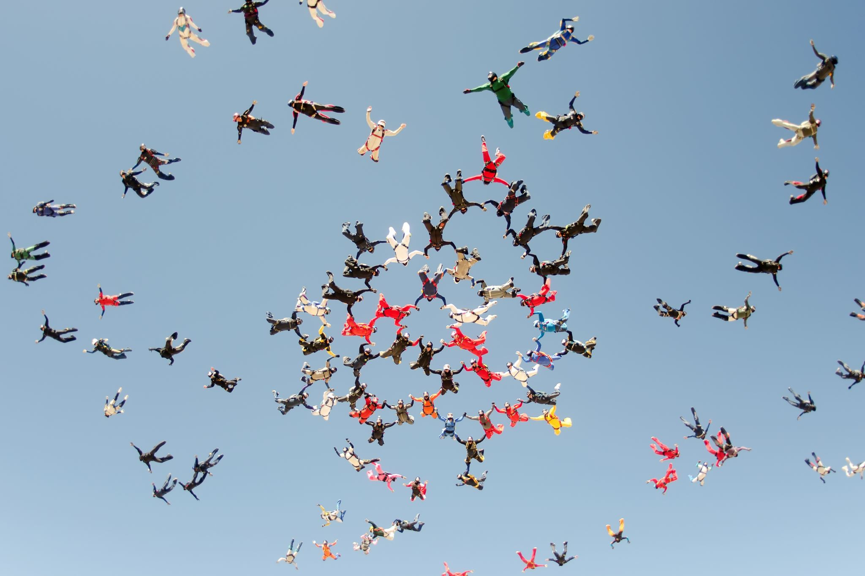
The middle
Once you’ve got your characters, setting and opening lines, things have to start happening!
These things build the suspense of the story. What problem or challenge does your character have to overcome?
BUT! We don’t need every detail! Keep it pacey. For example…

Slide 9

The end
How do your characters overcome their problems and challenges? This is where your story is probably at its most exciting.
Endings can be happy, sad or a cliffhanger, but it must wrap your story up in a big bow - no loose ends.
We want to read the end and smile or gasp or frown - not think whaaaaaaat? and then have a million questions in our head.

Slide 10
Top tips
Don’t try to make it perfect, keep writing and then go back and improve.
It isn’t a spelling competition! We want a STORY. But also, you must read it over and check it all makes sense. Have fun, let your imagination run wild!
Don’t be shy – let your family or friends read your story and ask them what they think. It’s useful to know if something doesn’t make sense.
500 words is not a lot of words so really plan your story out before you start to write and make sure you’re not repeating things or putting in unnecessary details. Time can skip forward in a story! You’re the boss.

Slide 11
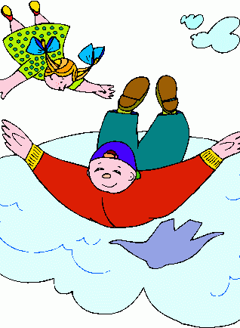
STORIES GIVE YOU WINGS!
This Photo by Unknown Author is licensed under CC BY-NC-ND

